Slide 1
COUNTRY REPORT ON ASSESSMENT OF NATIONAL NUCLEAR INFRASTRUCTURE – IN FIJI
A PRESENTATION AT THE 2016RCARO managed project
introductory workshop for new rca government parties on rca programme and its policy
23-25 Nov. 2016,
coral coast, fiji.
‘sOJI AJIBULU
FIJI NATIONAL UNIVERSITY, SUVA; FIJI

Slide 2
OUTLINE OF PRESENTATION
Geographical Map of Fiji
Brief Statistics on Fiji
Assessment of the National Nuclear Infrastructure in Fiji
Legal Framework
National Activities
Involvement in IAEA Programmes/Projects
International Cooperation
National Development Needs/Priorities/Plans

Slide 3
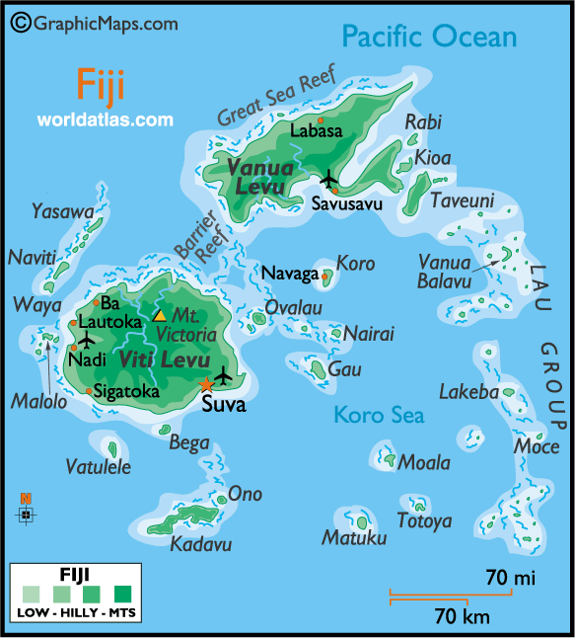
MAP OF FIJI

Slide 4
BRIEF STATISTICS ABOUT FIJI
An Island country in Oceania –one of 5 Melanesian nations in the South Pacific
Total Area – 18,274 sq.km.
Comprises of 333 islands. The 2 major ones (with about 87%population) are Vitilevu & Vanua levu. Ovalau, Kadavu and the Lau groups are sparsely populated.
Population – 896,038 (2015 estimate)
Official language – English, Fijian & Hindi

Slide 5
MAJOR AREAS OF APPLICATION OF RADIATION IN FIJI
There are 5 main areas of radiation application in Fiji. These are:
INDUSTRIAL
MEDICAL
AGRICULTURAL
ENVRONMENT
RESEARCH & DEVELOPMENT

Slide 6
ON INDUSTRIAL APPLICATION OF RADIATION IN FIJI
Due to lack of applicable radiation regulatory control in Fiji, radiation safety, security and liability are usually compromised, especially in the following industrial areas of Fiji’s economy:
Mining areas –
- Fiji has active mining exploration of Gold in Vatukuola
- Copper and Silver in Namosi in Vitilevu and
- Bauxite in Nabouwalu in Vanua levu.
However the use, exploration and detection of these minerals by radio-active sources, including regulation and audit of the sources in use cannot be verified, due to lack of standard regulatory agency
Ports Authority – importation, transport, handling & disposal of harmful radi0-active sources ignorantly are also of concern due to lack of regulatory agency to control & audit these sources

Slide 7
MEDICAL APPLICATION OF RADIATION IN FIJI
By far the largest use of radiation in all the five main areas is Medical.
Medical radiation activities in Fiji are mostly diagnostic at the moment, covering mostly contrast and non-contrast studies
Currently, there is no nuclear medicine studies available such as CT-PET & SPECT-CT
Active plans and efforts are under way to establish a Radiotherapy Centre in Fiji, with technical assistance and support from IAEA and WHO along a modified imPACT model

Slide 8
LIMITED BRACHYTHERAPY
Fiji currently runs a limited Brachytherapy service at the CWM Hospital in Suva – for asymptomatic treatment of Ca. Cervix by radium needles
There are however challenges with the treatment modality in the following areas:
1. storage and handling
2. transport and disposal
3. personnel monitoring of staff handling sources

Slide 9
CHALLENGES OF LACK OF RADIATION SAFETY INFRASTRUCTURE IN FIJI
These challenges include:
1. Establishing a data base of all users of ionising & non-ionising radiation in Fiji
2. Carrying out the inventory of all types of radiation sources in use in the country
3. Regular & periodic Inspection/audit of all radiation facilities in Fiji
4. Issuance of appropriate Licenses
5. Providing Standards for Calibration of equipment
6. Ensuring national standards of Patient Dosimetry is carried out optimally
7. Setting up National Diagnostic Reference Levels

Slide 10
8. Setting up mechanisms for Quality Assurance for medical exposures
9. Monitoring and Evaluation of practice standards
10. Provision of reports
11.Enforcement of and compliance with regulations
12.Radiation research and development

Slide 11
ON AGRICULTURE
On Agriculture – Non-availability of nuclear techniques to improve crop production – leading to poor crop (dalo) yield as a result of pests infestation in Northern Division of Fiji
Food irradiation– radio-active sources in use for tinned fish for preservation, canned food, alcohol, etc. cannot be verified– due largely to lack of audit & regulation
Lack of National Reference Guideline - for food safety, security and preservation
Lack of Standard testing laboratory - for seed analysis and crop production

Slide 12
ON FORESTS & FISHERIES
On Forests & Fisheries – challenges include:
Lack of Code of Conduct (CC) for safety, ethical & professional practice
Lack of forest biometrics & management for better forest yield
Lack of Standard Testing laboratory (STL) – for sampling
Ocean acidification with resultant negative impact on the fishing industry

Slide 13
ON ENVIRONMENT
On Environment, challenges include:
Lack of regulations/national standard policy on environmental protection guidelines (EPG) as there are no nuclear waste management facilities
Lack of national guidelines/framework on environmental impact assessment (EIA)
Lack of Standard testing laboratory (STL) – for sampling and nuclear techniques.

Slide 14
ON RESEARCH & DEVELOPMENT
On Scientific research, challenges include:
Lack of nuclear reactors - for generation of electricity and production of radio-isotopes
Lack of standard specialist laboratories for major radiation research and development
Lack of technical expertise to explore recent advances in radiation safety for policy formulation and implementation

Slide 15
LEGAL FRAMEWORK
Fiji has a Radiation Health Decree promulgated in 2009
Mandate of Decree is to regulate the use, sale, transport and disposal of radio-active sources in the country
Decree is currently under review by the office of the Solicitor-General of Fiji, after its informal review by OLA of IAEA
After proper review, it will be endorsed by the cabinet and passed by the Parliament
This will pave the way for Fiji to have a proper radiation safety regulatory infrastructure

Slide 16
NATIONAL ACTIVITIES
By virtue of being a new member of IAEA and RCA in the Asia-Pacific region (Membership of IAEA in Nov. 2012 & RCA in Aug. 2014), Fiji has had the following national activities undertaken:
Impact Study for the Establishment of a Radiotherapy Centre – March 2014
Workshop on how to draft a Country Programme Framework (CPF) - May 2015
Feasibility study on the Establishment of a Radiotherapy Centre – June 2015
Drafting of a Bankable document for the Radiotherapy Centre – Feb. 2016
Cost- Benefit Analysis for setting up a Radiotherapy Centre in Fiji – June 2016

Slide 17
INVOLVEMENT IN IAEA PROGRAMMES/PROJECTS
Title | Date | Context: Topics, outcomes, accomplishments
FIJ 5001: Examining Options for the Management of Fruit Flies | 2016 - 2019 | -Field of Activity: 23 -Project in Active status -Implementation rate: 56.2% in 1st year
FIJ 6001 Establishing a Radiotherapy Centre | 2016-2019 | -Field of Activity: 26 -Project in Active Status -Implementation rate: 97.93% in 1st year
FIJ 7001 Establishing an Environmental Monitoring Laboratory for the Protection of Marine Coastal Resources in the Context of Mining | 2016 – 2019 | -Field of Activity: 17 -Project in Active Status -Implementation rate: 58.73% in 1st year

Slide 18
INTERNATIONAL COOPERATION
Fiji has active collaboration and development cooperation with the following regional agencies in certain areas of nuclear science application and technology apart from IAEA:
South Pacific Commission (SPC)
European Union (EU)
Department of Foreign Aid and Trade, Australia (formerly AusAID)
New Zealand Agency for International Development (NZAID)
Japan International Cooperation Agency (JICA)
.

Slide 19
NATIONAL DEVELOPMENT NEEDS/PRIORITIES/PLANS
Fiji’s national development needs and priorities include:
1. Setting up a proper Radiation Safety Regulatory Infrastructure
2. Establishment of a Food Safety Laboratory
3. Setting up an Environmental Monitoring laboratory to control pollutants in the environment, as well as ocean acidification and salination
4. Nuclear Medicine facility to complement the Radiotherapy Centre
5. Water resource management
6. Climate change and adaptation studies
7. Capacity-building for Project Counterparts (CPs) and National Project Coordinators (NPCs)

Slide 20
ACKNOWLEDGEMENTS (Cont’d)
Vinaka vakalevu – which in Fijian language translates to:
THANK YOU VERY MUCH!

Slide 21
Any questions!!

